Slide 1
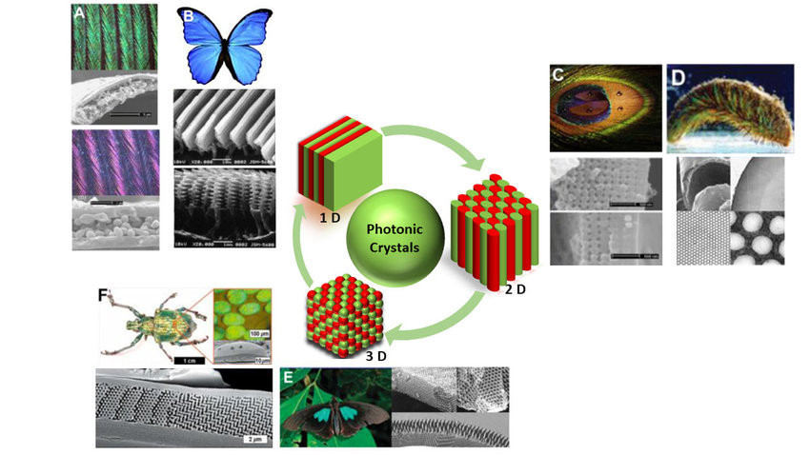
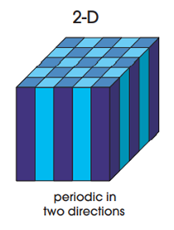
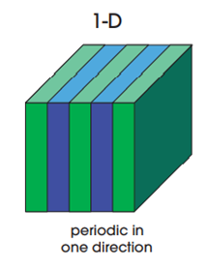
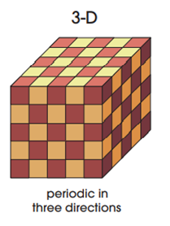
ML aided Inverse Design of 1D Photonic Crystals
by
Prof. Nikhil Ranjan Das
Institute of Radio Physics and Electronics
University of Calcutta
Chirantan Ganguly M.Tech. 1st Semester Functional Materials and Devices Roll No.: 23PH63R06

Slide 2
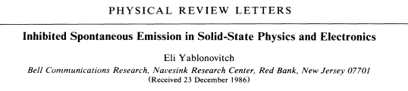
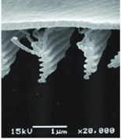

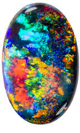
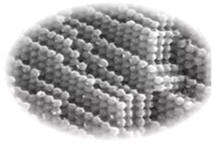
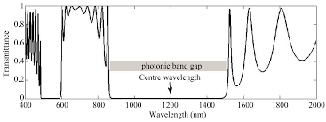
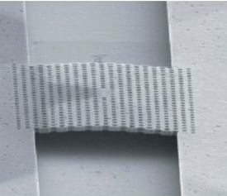
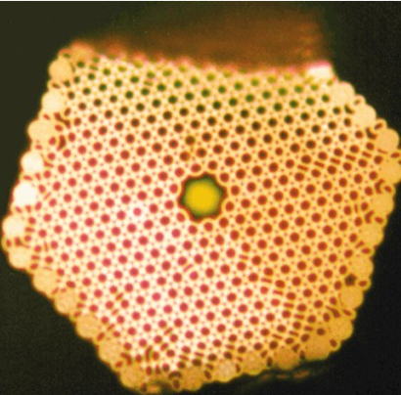
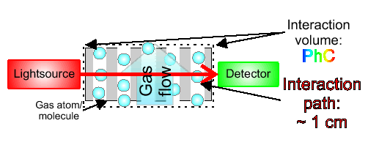
Photonic Crystals: Semiconductors of Light
Future Prospects for PhC application
5-10 years: | Photonic crystal “diodes” and “transistors”
10-15 years: | Photonic crystal logic circuits
15-25 years: | Optical computers driven by photonic crystals
Optical analog of electronic band gaps in semiconductors crystals
Some recently devised applications of PhC
[1] Yablonovitch, E. (1987). Inhibited spontaneous emission in solid-state physics and electronics. Physical review letters, 58(20), 2059.
Notes:
When we see in nature, the colour of objects are something which we happen to notice first. Such as the beautiful colours exhibited by the wings of a butter fly or the colour in opals. While some colours originate from chemical dyes, others originate from periodic arrangement of objects forming crystal like structures. Which is the case for the cases shown here. These crystals happen to be special kind of crystals called photonic crystals. The first formal study in this field was done in 1987 by Prof. Eli Yablanovitch. These Photonic crystals can be broadly classified into 3 types 1D, 2D and 3D crystals depending on the number of directions periodicity is present in. A special property of the photonic crystals is optical bandgaps, these optical bandgaps denote the wavelengths of light which are prohibited from being transmitted when incident on photonic crystals. These optical badgaps can be thought of as optical analogues of electronic bandgaps observed in semiconductor crystals. Synthetically fabricated photonic crystals are now finding uses in various applications such as electronically pumped single mode photonic crystal nanocavity LED, optical waveguides and gas sensors.

Slide 3
PhC device Design (Traditional) Procedure
Setting Target
Figure out Performance Requirement of PhC (bandgap, central freq. of bandgap etc.)
Finding apt. design
Search suitable material from a wide array of available materials (Intelligent guesses)
Solve equations to figure out the design specifications (layer thickness, number of layers etc.)
Experiment and see if works
Simulate the design -> get output.
If design does not satisfy requirement, repeat step 2 and find different structural specifications.
Select the application
If set target is met – go ahead with fabrication
Disadvantages?
Time consuming Design accuracy and efficiency not very high
We need to device a better process
Notes:
Synthetic PhC design can be fabricated using the traditional approach by taking the following steps.

Slide 4
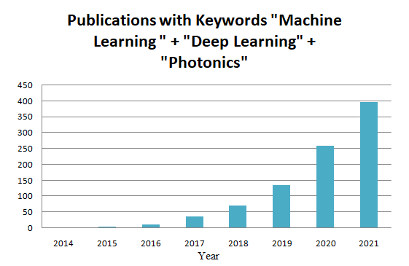
Literature Review
ML/DL aided Photonic Crystal Design is getting increasingly popular
Two ways ML/DL can help with PhC
Forward Design model:
2. Inverse Design model:
Design parameters
(materials, thickness of layers, number of periods)
Band gap structure
Band gap structure
Design parameters
(materials, thickness of layers, number of periods)
[2] Christensen, Thomas, et al. "Predictive and generative machine learning models for photonic crystals.“ Nanophotonics 9.13 (2020): 4183-4192.
[3] Chugh, Sunny, et al. "Machine learning approach for computing optical properties of a photonic crystal fiber," Opt. Express 27, 36414-36425 (2019)
[4] Ghosh, Alekhya, et al. "An approach to design photonic crystal gas sensor using machine learning." Optik 208 (2020): 163997.
[5] Zhan, Tao, et al. "A general machine learning-based approach for inverse design of one-dimensional photonic crystals toward targeted visible light reflection spectrum." Optics Communications 510 (2022): 127920

Slide 5
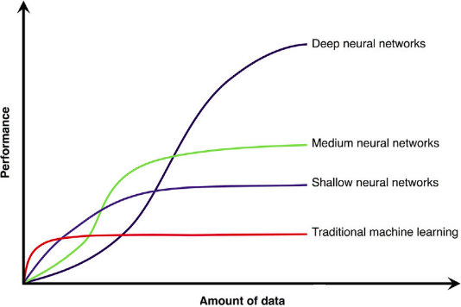
PhC device Design (ML/DL) Procedure
Setting Target
Figure out Performance Requirement of PhC (bandgap, central freq. of bandgap etc.)
Train ML/DL model
Train the ML/DL inverse design model with lots of example designs (structural specs. + bandgap struct)
Get Result
Input the required bandgap structure into the model
Select the application
Validate the model
Get the candidate structural specifications as output
Advantages?
Fast Accurate and efficient design
Requirement:
DATA – A lot of data, for training the models
Creating dataset: Transfer Matrix Method (TMM)

Slide 6
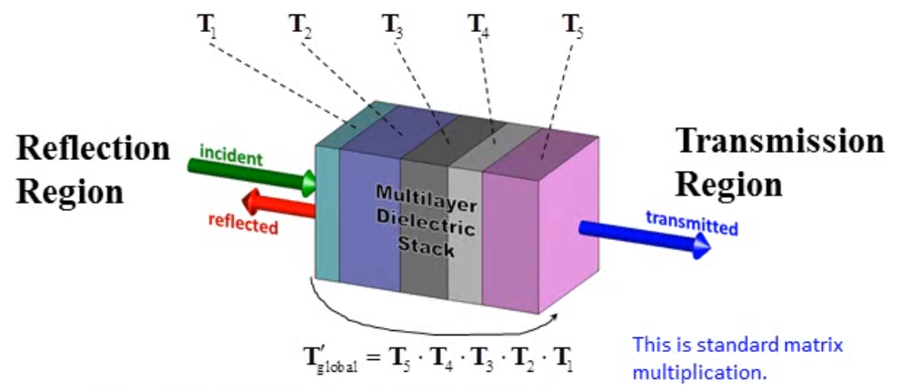
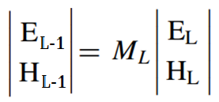
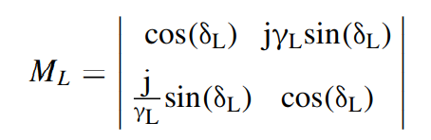
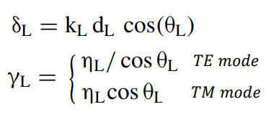
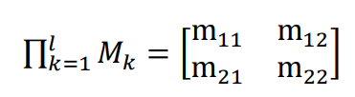
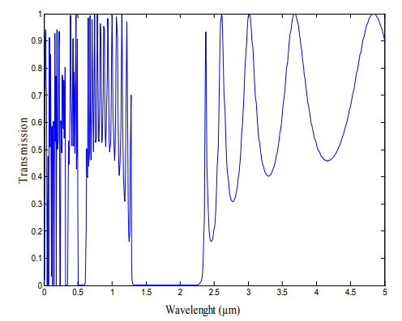
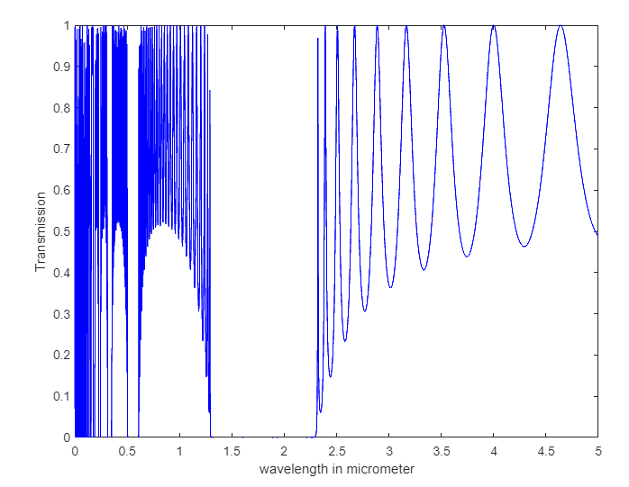


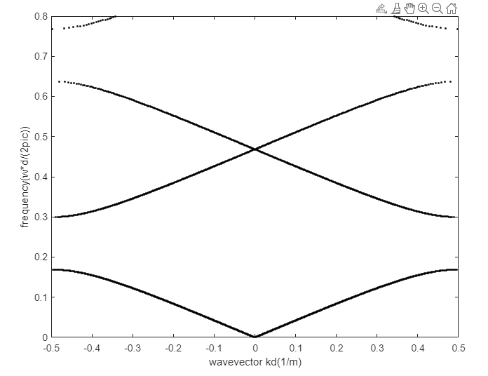


Transfer Matrix Method (TMM)
Applying Maxwell’s Eq. and Boundary conditions
M_{L} is the T matrix of Lth layer
Reflectance:
Comparing the results with the band gap given in [7]
Transmittance:
Photonic Band Gap
[6] J. B. Pendry et al., (1992), Calculation of photon dispersion relations, Phys. Rev. Lett. 69, 27722775
[7] Barkat, O. (2015). Theoretical investigation of transmission and dispersion properties of one dimensional photonic crystal. Journal of Electrical and Electronic Engineering, 3(2), 12-18.

Slide 7
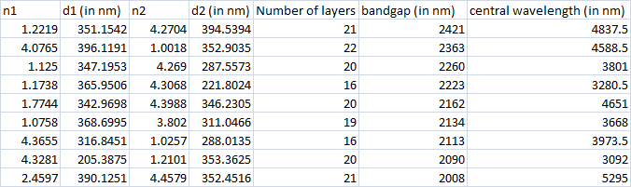
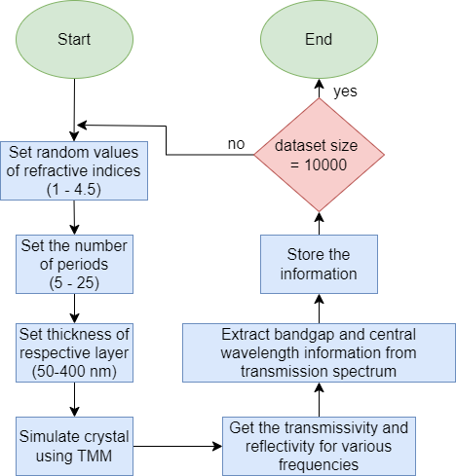
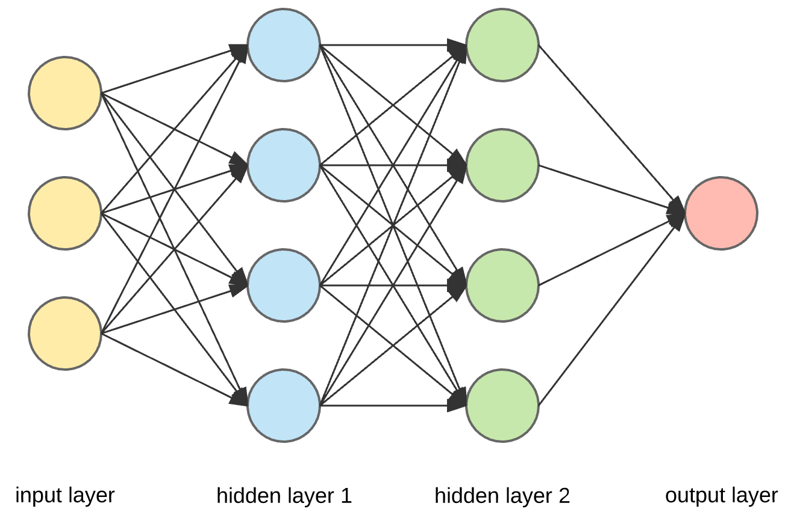
Creation of dataset and training DL models
Flowchart:
For Inverse Design DL model:
band gap and central wavelength - inputs
n1,d1,n2,d2, no. of layers - outputs
Size of dataset created | 10000+ data points (can be extended)
Train – Test split | Training: 80% Testing: 20%
Neural Network Structure | 4 layers
No. of neurons in each layer | Layer 1: 128 Layer 2: 64 Layer 3: 32 Layer 4: 2
Activation function used in each layer | Layer 1 -3: ReLU Layer 4: Linear
Mean Absolute Error : 33nm

Slide 8
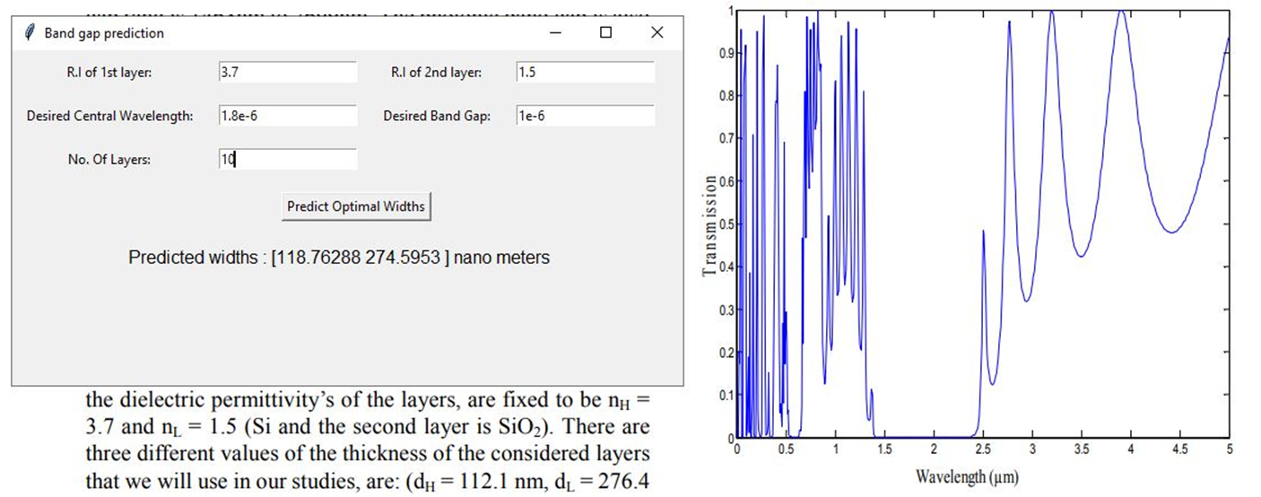
Designed GUI at work
Validating Predictions by comparing design with one given in [7]
BW: 1 um
λ_{c} : 1.8 um
[7] Barkat, O. (2015). Theoretical investigation of transmission and dispersion properties of one dimensional photonic crystal. Journal of Electrical and Electronic Engineering, 3(2), 12-18.

Slide 9
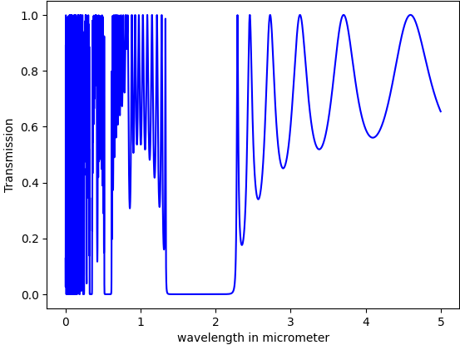
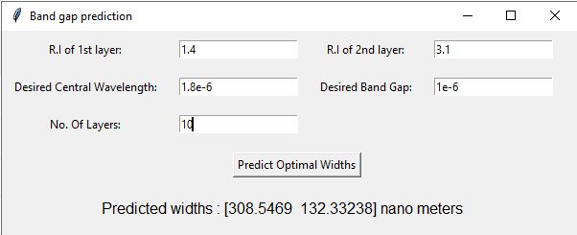
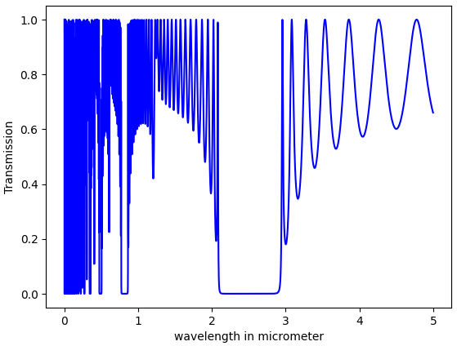
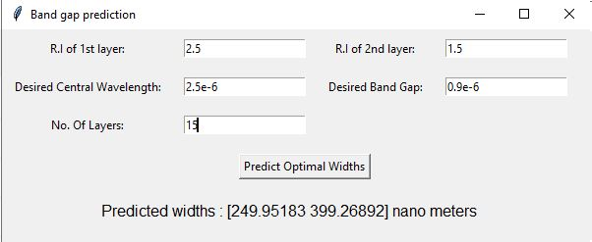
Designed GUI at work Contd…
BW: 1 um
λ_{c} : 1.8 um

Slide 10
Conclusion and our Future Work
Work Done
Thorough literature review of recent developments in PhC design
Study of PhC using computational methods
Creation of dataset for ML/DL model training
Training & testing of Neural Network for inverse design
GUI creation for ease of use.
Use the models for the designing of highly accurate application specific photonic crystal sensor (eg. blood sugar sensor)
Generalizing GUI for multidimensional PhCs
Exploring the defect states in PhCs using ML.
Future goals

Slide 11
THANK YOU

